Slide 1




Slide 2
JTAG protocol
“It's I2C for testing”
Popular transport layer for boundary-scan, debugging, etc
...but not limited to this.

Slide 3
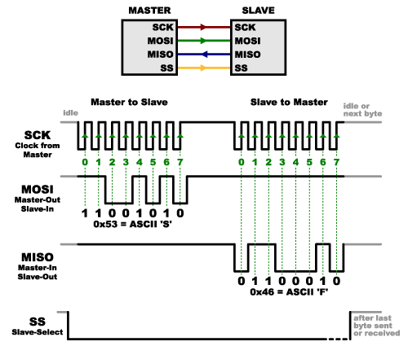
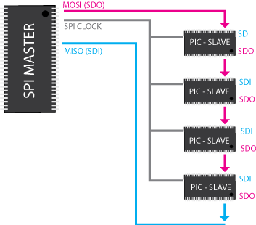
SPI
Signalling:
Daisy chaining:

Slide 4
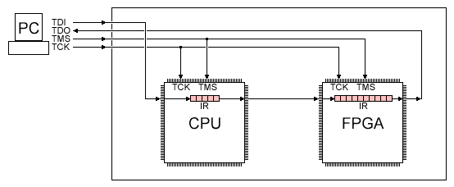
JTAG: a reconfigurable daisy chain.
One or more slave systems in the scan chain
  TAPs (Test Access Ports)
Each slave has multiple register options
  Instruction register (fixed bit-length, but same for all ICs)
  Data register (variable bit-length, based on instruction)
  More versatile, better performance for complex systems

Slide 5
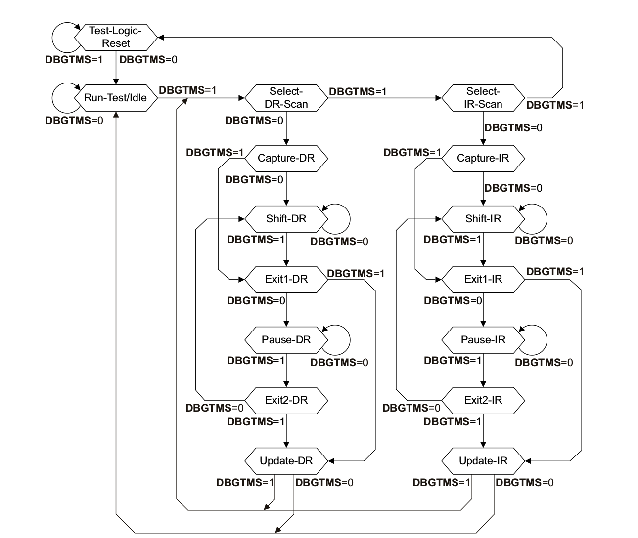
How? the TMS signal

Slide 6
Types of instructions
Mandatory:
BYPASS (1-bit DR) ← standardized instruction code
EXTEST (write access to device pins)
SAMPLE/PRELOAD (read access to device pins)
Other:
IDCODE (32-bit DR)
  Not mandatory, but often supported
  DR value identifies the TAP
  If supported, IDCODE data register is the default connected data register after reset (allows scan-chain discovery)
Other instructions are TAP-specific – usually allow some kind of data access

Slide 7
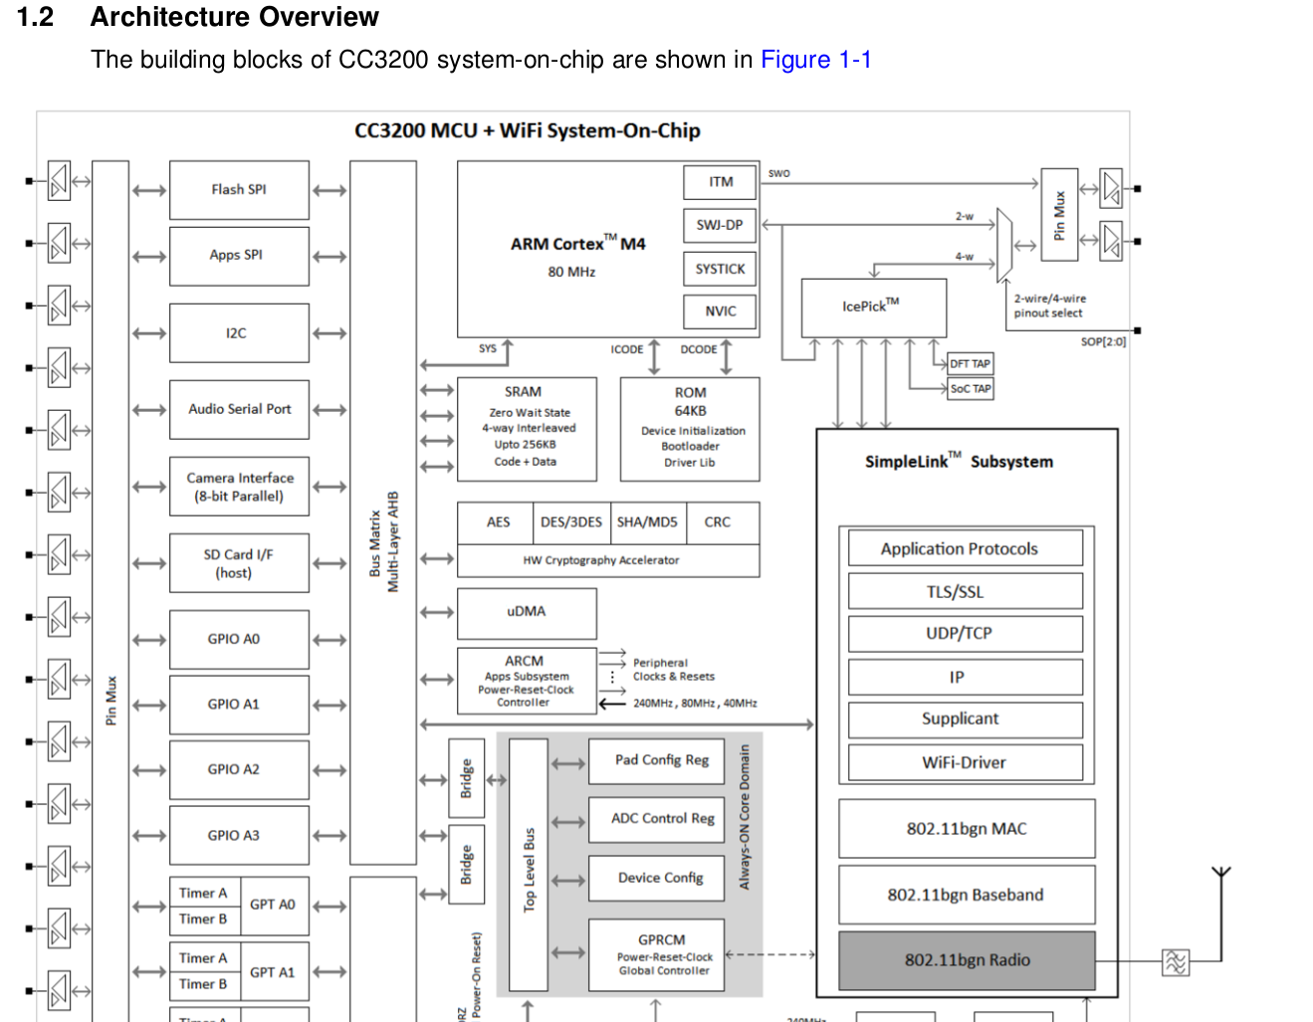
Example: CC3200 SoC

Slide 8
Example: CC3200 SoC
By default, only one TAP: TI's “ICEPICK” router.
  Can be configured to add various SoC internal TAPs to the scan chain.
  Generic documentation available, CC3200-specific configuration found in OpenOCD
Only internal TAP explicitly specified in the public datasheet is that of the user ARM Cortex M4 core.
  Presumably others for pin access, testing features, access to the Wi-Fi core, etc.
Debugging TAP scan chain configuration for CC3200:
ICEPICK TAP
Cortex M4 TAP
1
1
1
1
1
1
x
x
x
x
IR (6-bit)
IR (4-bit)
x
x
x
x
x
x
x
x
x
...
DR (1-bit in BYPASS)
DR (?-bit)

Slide 9

Example: CC3200 SoC
Q: So once we have access to the ARM core's TAP, what do we do?
  A: we need read a whole bunch of stuff first.
    ARMv7-M Architecture Reference Manual
    ARM Debug Interface v5 Specification
    ARM Cortex M4 Technical Reference Manual

Slide 10
Example: CC3200 SoC
Cortex M4 TAP
(same in all ARMv7-M
family processors)
MEM-AP
(same in all ARMv7-M
family processors)
access to “AP's”
via an address-based
access protocol
Memory-mapped debug registers
(Cortex M4-specific)
access to memory
via a another address-
based access protocol
System memory access
(Cortex M4-specific)
(other AP's)

